Slide 1


18 LESSONS FROM A 118-YEAR-OLD FAMILY BUSINESS
SPEAKER: JASON PACKER, FOUNDER OF STRIDE
Notes:
CUES
TIME: 1 min — clock 0:00 → 1:00
• RUN OF SHOW (49¾ min + Q&A): Open 0–3¾ · Selfridge 3¾–7¾ · Lessons 1–7 7¾–19½ · Lessons 8–13 19½–27¼ · The case 27¼–42¾ · Lessons 15–18 42¾–48¾ · Close 48¾–49¾ · Q&A to 60
• COLD OPEN: walk out with this slide behind you and go straight to the car story — no preamble
• Thank Brad + the Institute AFTER the tease
• Say the shape once: eighteen lessons, one case, and you will work
SCRIPT
Walk out, no preamble: “When I was a kid, my grandfather had me carry product out of our own warehouse and load it into his car. My father caught me. I will tell you what that argument taught my family in about ten minutes.” Then: “Thank you, Brad, and thank you to the Kim S. Miller Family Enterprise Institute for having me.”
Then the premise: every family business has a tax advisor, a lawyer, and a banker for the technical side of succession. Almost none of them have a plan for the people side — and the people side is what decides whether the business survives the handoff.
Then the shape, once: “Eighteen lessons. One case you are going to argue about with the person next to you. Let’s go.”

Slide 2
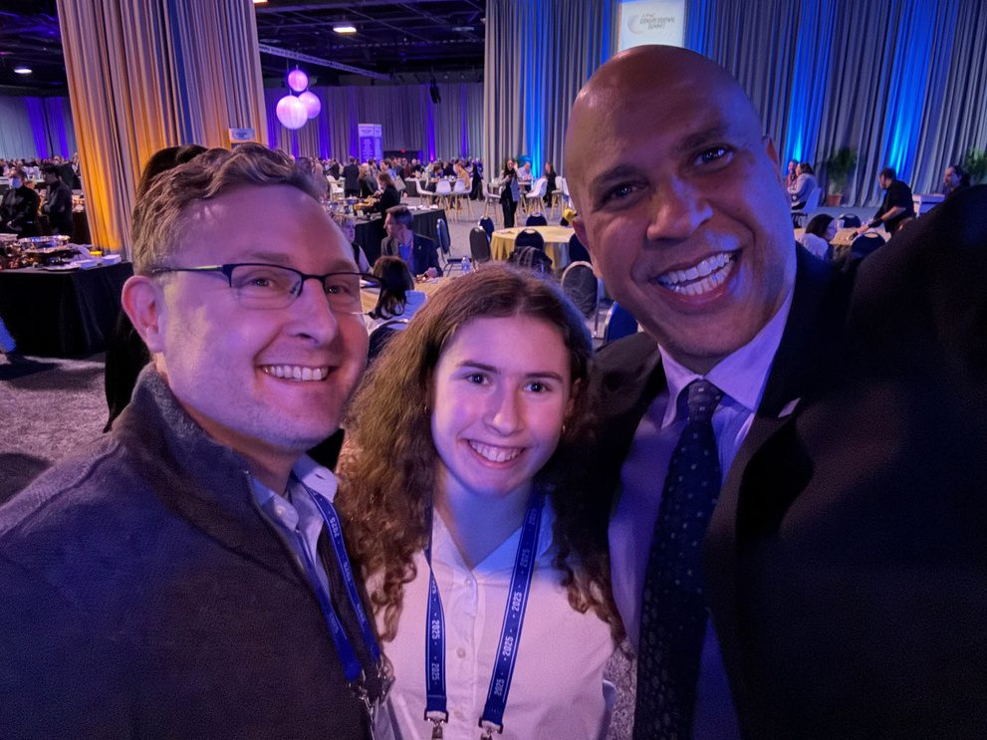
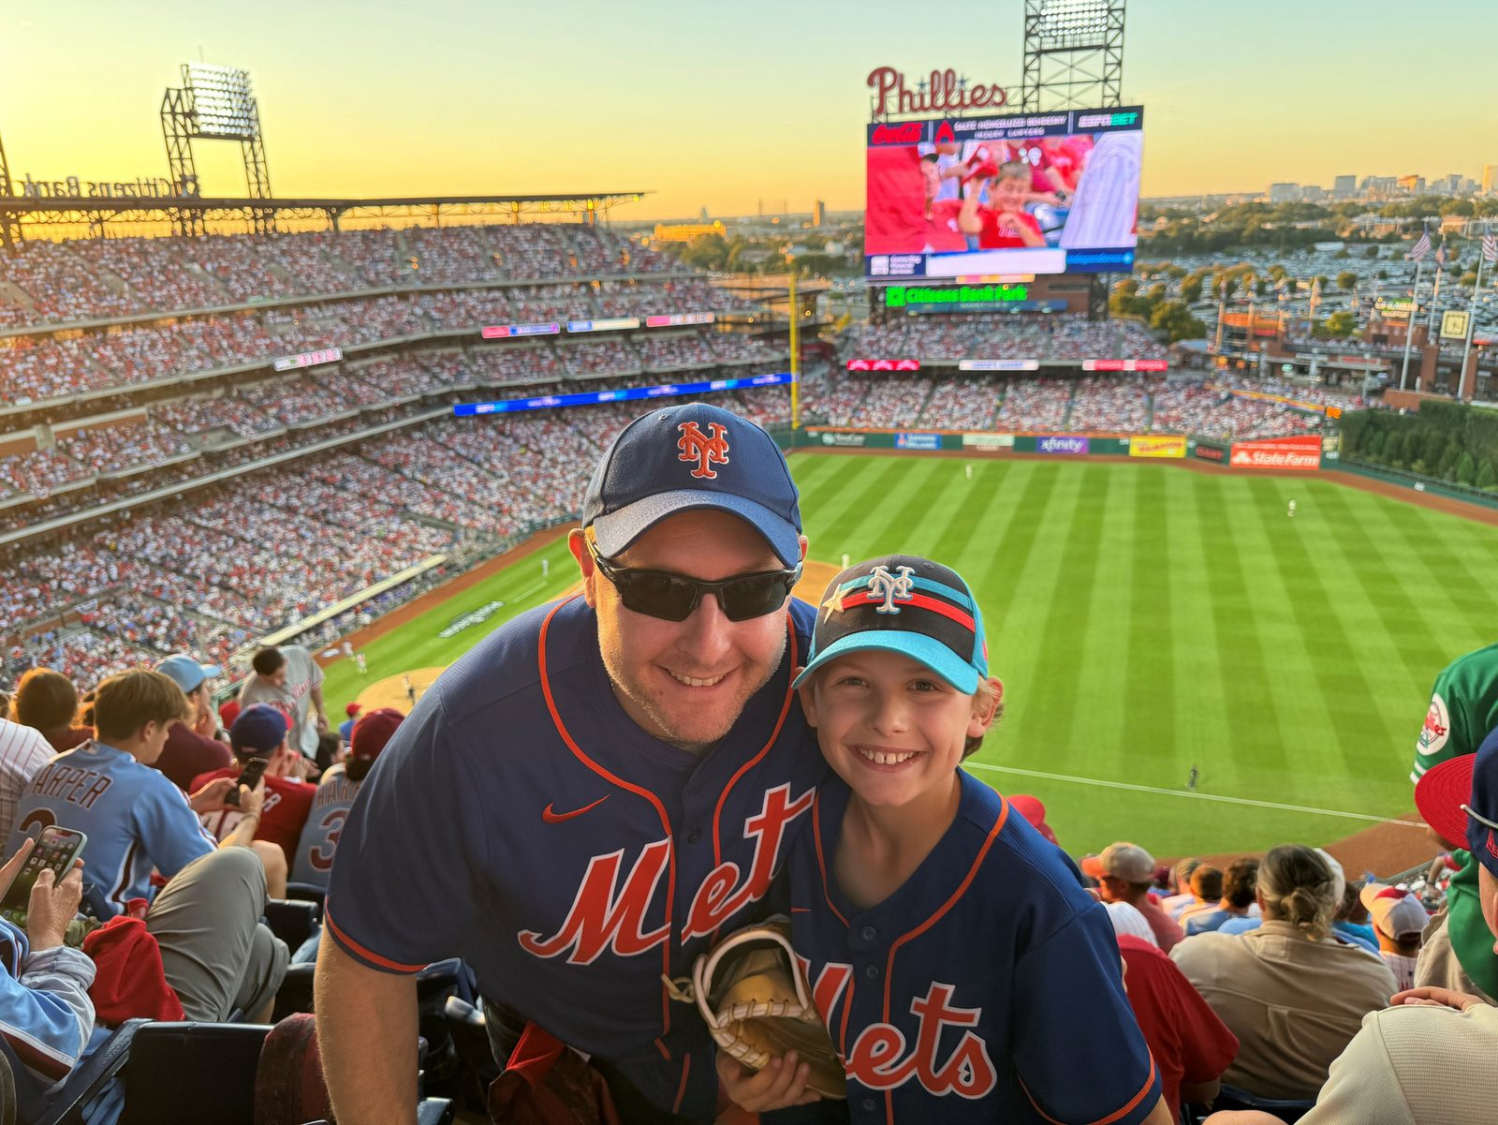
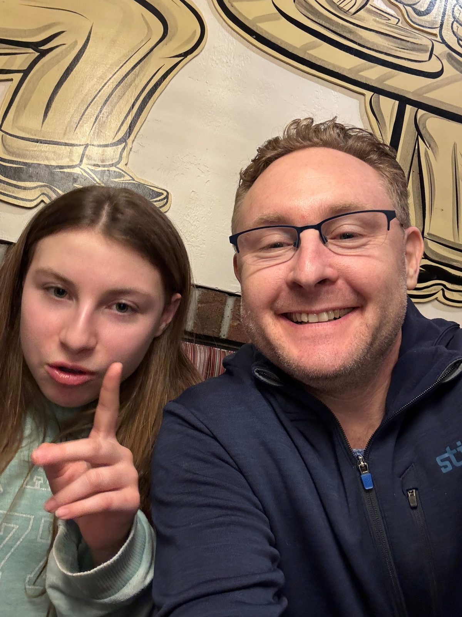

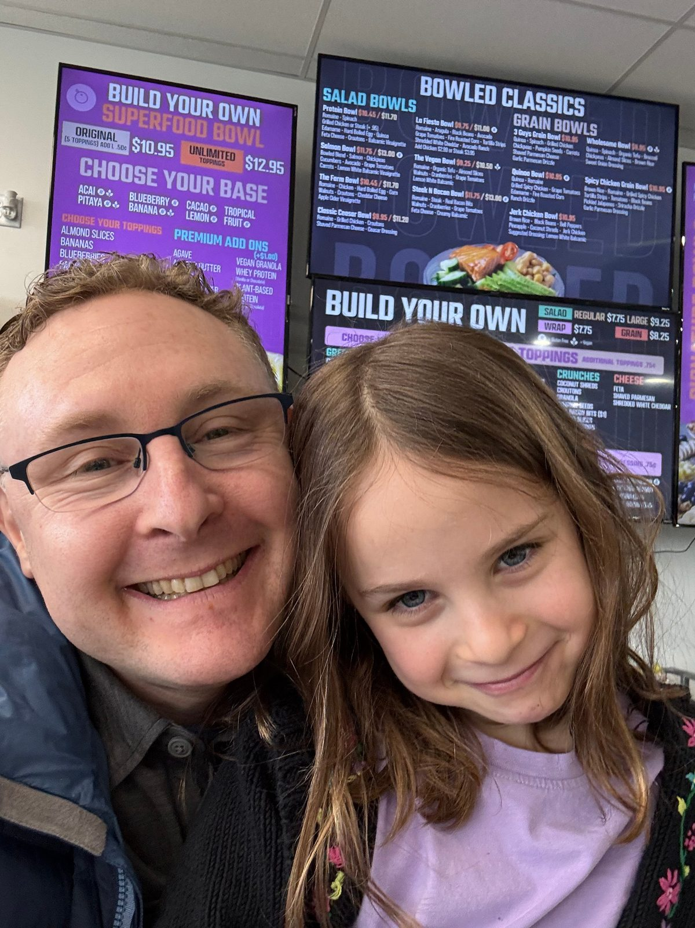
Jason Packer: Husband, Dad, Mets Fan
4th generation · 16 years as CEO · sold in 2022
Notes:
CUES
TIME: 0.75 min — clock 1:00 → 1:45
• 45 seconds
• Husband, dad, Mets fan
• The credibility line is on the slide — do not read it
• Why I am here
SCRIPT
Before the credentials, the real résumé. Husband to Lisa. Dad. And a Mets fan — which explains my high tolerance for long-term suffering, a skill that turns out to be very useful in a family business.
[Point out one photo — one sentence.] The line under the title is the only time the résumé comes up: fourth generation, sixteen years as CEO, sold in 2022. Everything today comes from those three facts.

Slide 3
Family Business Legacy Timeline
Four Generations of Entrepreneurship & Excellence
4
generations
Finkle Distributors
1920s – 2010
Sold in 2010 • Founded the family distribution legacy
4×
industry average, 2022 sale
Hill & Markes
Packer Meats
Acquired 1940s – Sold 2022
1930s – 1990s
Sold to BradyIFS at 4x industry average valuation
Bankruptcy in 1990s • Separate family venture
Wustefeld Candy Co.
?
generation five
Acquired 1940s – Sold 2021
Sold to National Convenience Distributors • 120+ years serving convenience stores
Stride Family Business Alliance
Founded 2020s – present
Notes:
CUES
TIME: 2 min — clock 1:45 → 3:45
• Four businesses, four generations
• Finkle: candy & distribution
• Packer Meats: the cautionary tale
• H&M 1906 → 2022, 4x industry average
• Wustefeld: 120+ years
• Stride: what I do now
SCRIPT
Four generations, four businesses. Two were sold well. One went bankrupt. And one became what I do now.
Finkle Distributors — the Finkle side of the family, the candy and distribution legacy, 1920s to 2010. [One line on who started it and what they sold.]
Packer Meats — a separate family venture, 1930s to the 1990s, ended in bankruptcy. I keep it on this slide on purpose. Every family has a business that did not make it, and the lessons from the one that failed are usually more honest than the lessons from the ones that worked. [One line on what went wrong.]
Hill & Markes — founded in 1906, in our family since the 1940s. I ran it for sixteen years and we sold it to BradyIFS in 2022 at four times the industry average valuation. Hold on to that number; we will come back to how a family gets there.
Wustefeld Candy — one hundred twenty-plus years serving convenience stores, sold to National Convenience Distributors in 2021.
And Stride, the family business community I founded after the sale. More on that at the end.

Slide 4

Mr. Selfridge: Looking at Legacy
Notes:
CUES
TIME: 2 min — clock 3:45 → 5:45
• PLAY: Mr. Selfridge clip (2–3 min)
• One-line setup only
• Tell them what to watch for
SCRIPT
We are going to start with a story that is not mine. Harry Selfridge built one of the great department stores in the world — and this scene is about what happens to a legacy when the founder is the legacy.
Watch for three things: who is talking about the future of the business, who is not in the conversation, and what the founder thinks he is protecting. [Adjust to the specific scene you are showing.]
PLAY the clip. Link is on the slide image; click it to open YouTube. Have it cued to the right timestamp before you walk on.

Slide 5

What caught your attention about this scene?
THE DEEPER QUESTION
Who in your family can disagree with you about the business — and what happens to them when they do?
Notes:
CUES
TIME: 2 min — clock 5:45 → 7:45
• Take 3–4 answers from the room
• Listen for: control, identity, silence
• THEN the deeper question — read it, then ten full seconds of silence
• Bridge to Lesson Three
SCRIPT
What caught your attention? [Take three or four answers. Repeat each one back so the room hears it.]
What I hear every time I show this: the founder cannot separate himself from the store. The next generation is either fighting him or silent. And nobody has a system for disagreeing — they just disagree.
Now the deeper one. [Read it off the slide, slowly.] Who in your family can disagree with you about the business — and what happens to them when they do? Name the person in your head. Now think about the last time they did it. [Ten full seconds of silence. Take two answers if they come — one from a senior-generation owner, one from a successor, if you can. If nobody speaks, say it gently: “That silence is the most honest answer in the room, and it is why we are here.”]
Harry Selfridge cannot tell where he ends and the store begins. Before we talk about fixing that, we need to understand where it comes from — because it comes from somewhere good. Lesson One.

Slide 6
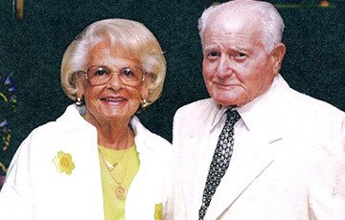
LESSON 1 OF 18
LESSON ONE:
STORIES THAT SHAPED OUR FAMILY CULTURE
  Hard Work & Persistence
  Compassion and Philanthropy
  Candy Makes People Happy
  Faith and Rest
  Brandy & a Cigar
Gratitude for the generations that came before me.
Notes:
CUES
TIME: 1.5 min — clock 7:45 → 9:15
• Grandparents photo
• Culture = the stories we keep telling
• 5 stories, one line each
• Closer: gratitude for the generations before me — look at the photo
• Ask: what are your family’s five?
SCRIPT
Lesson One. Culture is not a poster in the break room. Culture is the stories a family keeps telling. These are my grandparents, and these are the five stories that shaped ours.
Hard work and persistence — [one sentence]. Compassion and philanthropy — [one sentence]. Candy makes people happy — this is the Finkle side; the elders all sold candy, and that sentence was basically the business plan. Faith and rest — [one sentence]. Brandy and a cigar — [one sentence; this is the one the room will remember, so give them the ritual].
And underneath all five is the line at the bottom of the slide: gratitude for the generations that came before me. [Turn and look at the photo; give it a beat.] Every one of those stories cost them something — and I got to inherit it for free. That is the posture a successor needs. Not entitlement. Gratitude.
Your family has five of these too. If you cannot name them, your next generation definitely cannot. Write them down this week.

Slide 7
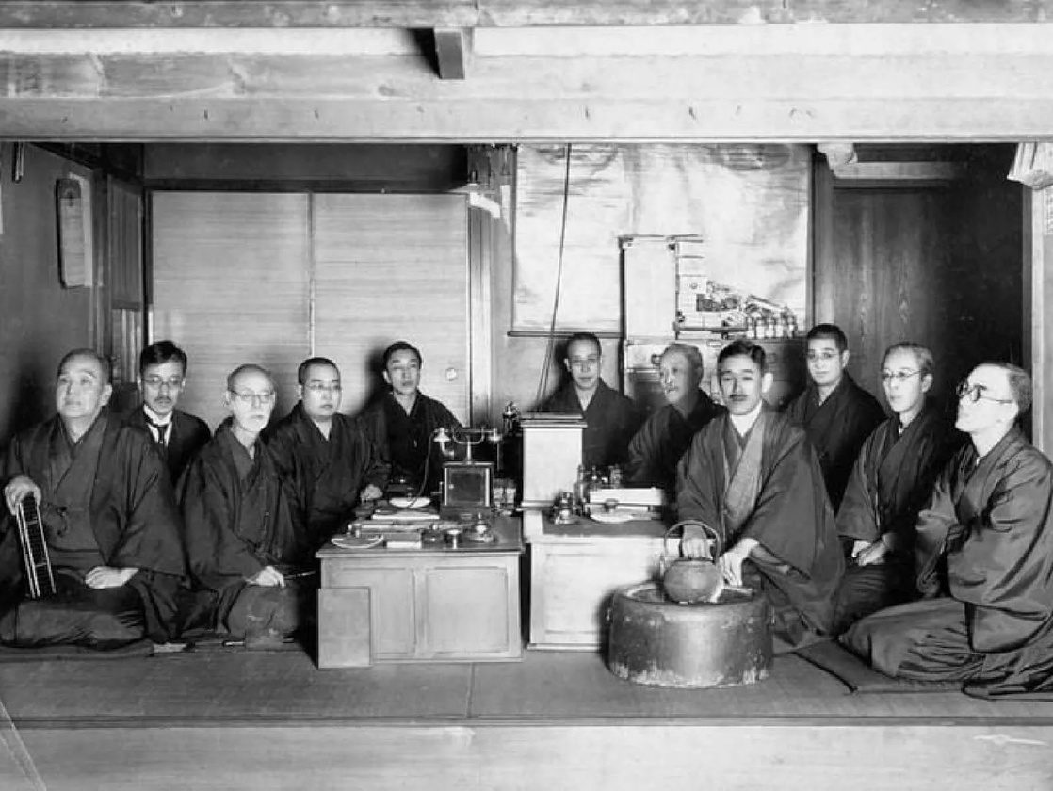
LESSON 2 OF 18
LESSON TWO: THE POWER OF A FAMILY CONSTITUTION
Desire peace. Never fight; respect all.
Keep faith; it brings a peaceful mind.
Be polite — the master first, then all.
Politeness governs young and old alike.
Virtue is the cause, fortune the effect.
Keep discipline, diligence, and order.
The right person in the right place.
Educate the children — body and mind.
Love all; a kind tongue keeps the peace.
Humble and diligent, as our forefathers.
Earn by sweat, not speculation.
Compete, but not to extremes.
Reward good service; correct mistakes.
Consult the family before any new venture.
No careless debt. You are not a bank.
Save — and give to society, unrewarded.
Never decide important affairs alone.
Kikkoman: the Mogi family has made soy sauce in Noda, Japan, since the 1600s. Its family constitution is seventeen articles long. Three of them, in bold, are the whole talk.
The Mogi family constitution, translated from Japanese and paraphrased here; full text in the notes. Articles 1, 9 and 17 are in bold.
Notes:
CUES
TIME: 2.5 min — clock 9:15 → 11:45
• Photo first: the Mogi family, 1600s
• Do NOT read all 17 — pick three (suggest 1, 9, 17; or 7, 15, 17)
• Notice: none of them is about soy sauce
• Article 15 = Kongo Gumi’s epitaph (40 generations, undone by debt in 2006)
• Ask: which one would your family fight about?
SCRIPT
Lesson Two: the power of a family constitution. Kikkoman — the soy sauce — is the Mogi family, making soy sauce in Noda, Japan, since the sixteen hundreds. Long ago they wrote down how the family would treat each other, in seventeen articles, and it still shapes how the company describes itself.
They are all on the slide, paraphrased so they fit. Do not read them out loud — pick three. One: desire peace, never fight, respect each other. Nine: words are the door to fortune and misfortune; a kind tongue keeps everything peaceful. Seventeen: never decide important affairs alone; consult the people concerned first. Hold on to that one — it comes back in the case study.
If you want a fourth: fifteen. No careless debt, no reckless guarantees, you are not a bank. The oldest company in the world, Kongo Gumi — fourteen hundred years, forty generations of temple builders in Japan — died in 2006 of exactly that: debt nobody in the family had the standing to question.
Notice what is not here. Not one article is about soy sauce. Every one is about how the family behaves — toward each other, toward employees, toward money. A constitution is just tradition you can hand to someone who was not in the room when the tradition was made. An in-law. A grandchild. A non-family CEO.
Quick question for your table: which one of these seventeen would your family fight about? [Take two answers. Fifteen and seven usually win.]
FULL TEXT (translated from Japanese), for reading aloud or a handout:
1. All family members desire peace. Never fight, and always respect each other. Ensure progress in business and the perpetuation of family prosperity.
2. Loving God and Buddha is the source of all virtue. Keeping faith leads to a peaceful mind.
3. All family members should be polite to each other. If the master is not polite, the others will not follow.
4. Sin is the result of being impolite. Families — young and old, masters and workers — govern themselves by politeness; then peace will be brought of their own accord.
5. Virtue is the cause, fortune the effect. Never mistake the cause for the effect. Never judge people on whether they are rich or not.
6. Keep strict discipline. Demand diligence. Preserve order — young and old, masters and workers.
7. Business depends upon people. Do not make appointments or dismissals using personal prejudices. Put the right man in the right place. Loving men who do what they should brings peace to their minds.
8. Education of the children is our responsibility to the nation. Train the body and mind with moral, intellectual, and physical education.
9. Approach all living beings with love. Love is fundamental to human beings and the source of a life worth living. Words are the door to fortune and misfortune. A foul tongue hurts oneself and others. A kind tongue keeps everything peaceful. Be careful in every word you speak.
10. Keep humbleness and diligence, which have been handed down over the years from our forefathers. Make every effort to do as much as you can.
11. True earning comes from the labor of sweat. Speculation is not the best road to follow. Don’t do business by taking advantage of another’s weakness.
12. Competition is an important factor in progress, but avoid extreme or unreasonable competition. Strive to prosper together with the public.
13. Make success or failure clear; judge fairly punishment and reward. Never fail to reward good service, and don’t allow a mistake to go unpunished.
14. Consult with family members when starting a new business. Never try to do anything alone. Always appreciate any profit made by your family.
15. Don’t carelessly fall into debt. Don’t recklessly be a guarantor of liability. Don’t lend money with the purpose of gaining interest, because you are not a bank.
16. Save money from your earnings, and give to society as much as you can. But never ask for a reward nor think highly of yourself.
17. Don’t decide important affairs by yourself. Always consult with the people concerned before making a decision. Then employees will have a positive attitude in their work.
Source: the Mogi family constitution as presented by Yuzaburo Mogi (Family Business Magazine, 1995), in the 17-article numbering used at irabryck.com. Some sources count 16 by combining articles 3 and 4.

Slide 8
LESSON 3 OF 18
LESSON THREE: AGREE ON HOW TO FIGHT
Grandpa Harry’s way
He’d send me into our own warehouse for product, have me sell it, and bring the cash home. Relationships first; paperwork later.
Dad’s way
An accountant: every case counted, every dollar through the books. The cash drove him crazy.
The day it blew up
Grandpa asked me to load product into his car. Dad caught me — and yelled at Grandpa, not at me.
They never agreed about the car. They learned how to argue about it.
The model — “Successors should enter into comprehensive discussions with their parents to develop agreed-upon systems to cope with differing management styles and the inevitable differences of opinion.” Willem van Eeghen, 14th generation, Van Eeghen, est. 1662
Source: O’Hara, W. T. (2004). Centuries of Success: Lessons from the World’s Most Enduring Family Businesses. Adams Media.
Notes:
CUES
TIME: 2 min — clock 11:45 → 13:45
• Pay off the cold open — this is the car
• Grandpa Harry: relationships first, cash home
• Dad the accountant: it drove him crazy
• The day Dad caught you — and yelled at Grandpa, not at you
• They learned how to argue
• Van Eeghen: build the system for disagreeing before you need it
SCRIPT
Lesson Three: agree on how to fight. And here is the car. [Your age, the year, what the product was.] My grandfather Harry built his business on relationships. He would send me into our own warehouse for product, have me sell it, and bring the cash home. That was how he had always done it.
My father is an accountant. Every case counted, every dollar through the books. Grandpa’s cash drove him crazy. And one day Grandpa asked me to load product into his car, and my father caught me doing it — and he did not yell at me. He yelled at Grandpa. [Thirty seconds of the scene: where you were standing, what each of them said, what you did with the box in your hands.]
Here is what matters about that fight. They never agreed about the car. What they learned was how to argue about it — out loud, about the business, with the kid out of the middle. That is the lesson. Not “agree.” Families that last do not agree more than other families. They have a way to disagree.
There is a family in Amsterdam that has been in business since 1662 — fourteen generations. Willem van Eeghen’s advice to successors, on the slide: sit down with your parents and build an agreed-upon system to cope with different management styles and the inevitable differences of opinion. Three hundred and sixty years, and the advice is: decide how you will fight before you have to.
[Ask the room:] When the two generations in your company disagree about the business, how do you actually decide? If the honest answer is “whoever is loudest” or “whoever owns more,” you have what my family had before that day in the warehouse.

Slide 9
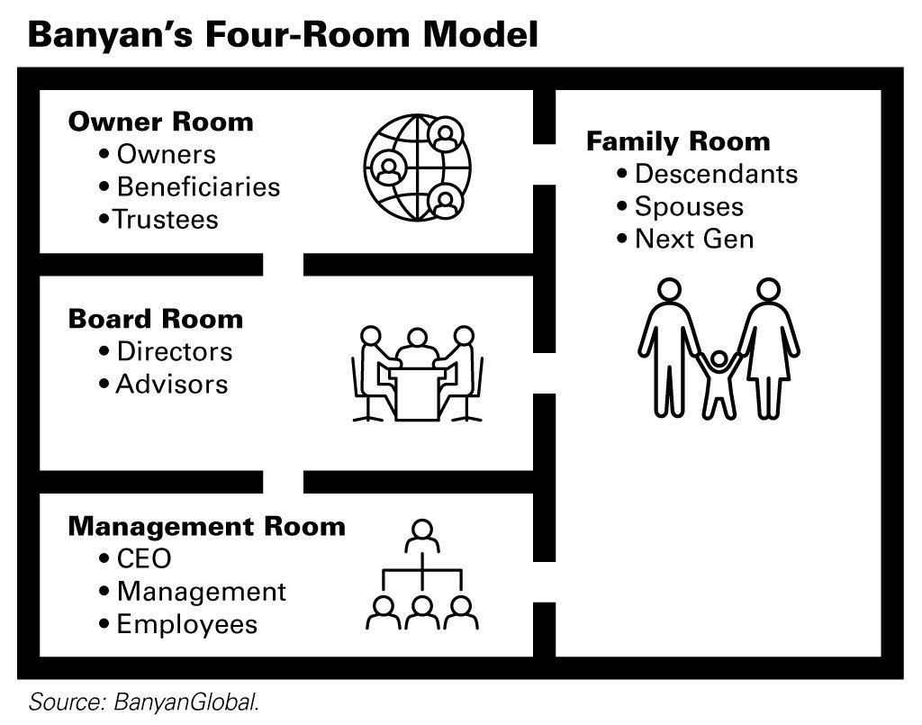
LESSON 4 OF 18
LESSON FOUR: THE FOUR-ROOM MODEL
My orientation, 2009
I came home to Hill & Markes, and my first assignment was not sales. It was keeping my uncle from suing my father.
Ron
Ron Reece, our family advisor, did not pick a side. He walked the owners into the owner room:
  A distribution policy. In a good year, owners get dividends — not bonuses.
  Pay for the job. Family in the business earn market pay for the job they actually do.
They were shouting from different rooms. The fix was a room.
The Four-Room Model: Josh Baron & Rob Lachenauer, Banyan Global (famcap.com) — owner room, board room, management room, family room.
Notes:
CUES
TIME: 2 min — clock 13:45 → 15:45
• 2009: recruited home from DC — and the first job was the lawsuit
• Uncle vs. Dad, 50/50 — shouting from different rooms
• Ron did not pick a side; he built the room
• Two policies: dividends for owners, market pay for the job
• Four rooms: owner, board, management, family (Baron & Lachenauer)
• Ask: which room does your family actually have?
SCRIPT
Lesson Four: the four-room model, and I learned it in my first month. I came home to Hill & Markes in 2009, and my orientation was not sales or operations. It was keeping my uncle from suing my father. Fifty-fifty owners, two brothers-in-law, and every argument about money was happening in the same conversation as every argument about family. [One line on what the fight was actually about.]
Ron Reece, our family advisor, did not pick a side. He walked the owners into a room the family had never built — the owner room — and put two policies on the table. A distribution policy: in a good year, owners get dividends, not bonuses. And pay for the job: family members in the business earn market pay for the job they actually do. Structure, not money. [What changed after that — one line.]
That is the four-room model. Josh Baron and Rob Lachenauer at Banyan say a family business needs four rooms, the way a house separates the bedroom from the kitchen: an owner room, a board room, a management room, and a family room. Most family fights are not about the issue. They are about the room. My uncle and my father were shouting from different rooms. The fix was a room.
Ask yourself: which of these four rooms does your family actually have? Most families I meet have one, and it has a kitchen table in it.

Slide 10


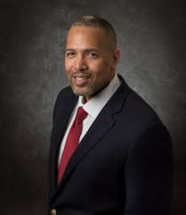


LESSON 5 OF 18
LESSON FIVE:
BUILD GOVERNANCE TO PROMOTE SUCCESSION
Governance gives every generation a voice
— and the next one a way in.
Notes:
CUES
TIME: 1¼ min — clock 15:45 → 17:00
• Dark slide: let the line sit before you speak
• Board photos — name them in one breath
• Governance = every generation a voice, the next one a way in
• Callback: Kongo Gumi (from the Kikkoman slide)
SCRIPT
[Let the room read the line. Count to three.] Governance gives every generation a voice — and the next one a way in. That is what a board is for in a family business. Not to take decisions away from the family. To give the family a way to make them together.
[Name the board members in the photos — one breath, what they changed.] Governance is not bureaucracy. It is the room where the senior generation gets heard without having to win, where outside advisors can say what the family cannot, and where the next generation learns how decisions get made — and earns a seat at them.
Remember Kongo Gumi from the Kikkoman slide — fourteen hundred years, and no room where someone could say “we are borrowing too much.” Build the room, and someone gets to say it.

Slide 11




LESSON 6 OF 18
LESSON SIX:
THE NON-FAMILY EXECUTIVES
A loyal core of non-family leaders gives the family the confidence to let go.
Notes:
CUES
TIME: 1¼ min — clock 17:00 → 18:15
• Four execs — name them
• A loyal core = the confidence to let go, and a buffer
• Treat them as partners: role, upside, what happens at sale
SCRIPT
Lesson Six: the non-family executives. [Name them. One line each on what they carried.]
A loyal core of non-family leaders is what gives a family the confidence to let go. They are the ballast: they keep the thing steady while the family works out its drama, and they are the buffer between the generations when the generations need one.
Treat them like partners. Clarity on the role, clarity on the money, and clarity on what a sale would mean for them — before a sale is on the table. The people who will run the company when you can’t should hear it from you, in writing, long before they have to.

Slide 12


LESSON 7 OF 18
LESSON SEVEN:
PEER GROUPS AND STRUCTURE
SUPPORT SUCCESSION
Peers who aren’t your family — and a room where you can talk about your family.
Notes:
CUES
TIME: 1¼ min — clock 18:15 → 19:30
• Vistage = peers who are not your family, where you can say the true thing out loud
• EOS = structure: seats by capability, not birth order
• Two things that saved me as CEO
• This is what Stride is built on
SCRIPT
Lesson Seven: peer groups and structure support succession. Two things saved me as a CEO, and neither was a consultant.
The first was a peer group — Vistage. A room full of other CEOs where I was not the boss, not the son, not the owner. Just a guy with a problem — and a room where I could talk about my family, out loud, to people who had no stake in it. There is no substitute for that.
The second was an operating system — EOS. Quarterly rocks, a scorecard, a weekly meeting with an agenda, and seats filled by capability, not birth order. It sounds mundane. It is not. Structure gives the family a place for the business — and it gives the family conversation a place of its own, instead of leaking into every meeting.
This is, not coincidentally, what Stride is built on. Peer groups plus structure. More at the end.

Slide 13

LESSON 8 OF 18
LESSON EIGHT:
LISTEN TO THE NEXT GENERATION EARLY ON
Low light, a dizzying stretch wrapper, and a father who listened.
Notes:
CUES
TIME: 1.5 min — clock 19:30 → 21:00
• Tell the story before you name the lesson
• You, young, on the warehouse floor: the lights and the stretch wrapper
• Dad did not explain — he listened, then FIXED both, for the company
• Lesson: the next generation sees things before it runs things
• Ask the room: what has your next generation already told you?
SCRIPT
Lesson Eight starts with my father, not with me. [Your age and the year.] I was new on the warehouse floor at Hill & Markes, and two things bothered me. The lighting was so low that by the back of the pick line you were reading labels by feel. And the stretch wrapper — the machine that spins a pallet while it wraps it in plastic — spun fast enough that whoever ran it walked away dizzy. [Thirty seconds of the memory: what it looked like, what it sounded like, what it felt like stepping off that machine.]
So I told my dad. Not in a meeting. On the floor, the way a kid tells his father something. And here is the whole lesson: he did not explain to me why it had always been that way. He listened — and then he fixed both. Better lighting. A wrapper nobody got sick on. Not for his kid. For the company.
Lesson Eight: listen to the next generation early on. The next generation sees things before it is ready to run anything. If you listen early, and act on what you hear, two things happen. The business gets better — and the kid finds out that his voice counts here. That is the day a successor starts to belong. It happens years before anyone says the word succession.
[Turn it to the room.] Senior generation: what has your next generation already told you that you have not fixed yet? Next generation: what have you stopped saying, because nobody acted the first time?

Slide 14
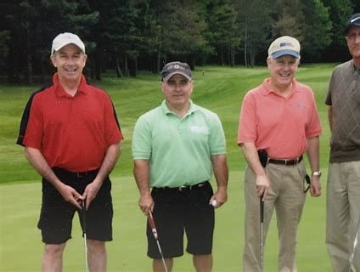
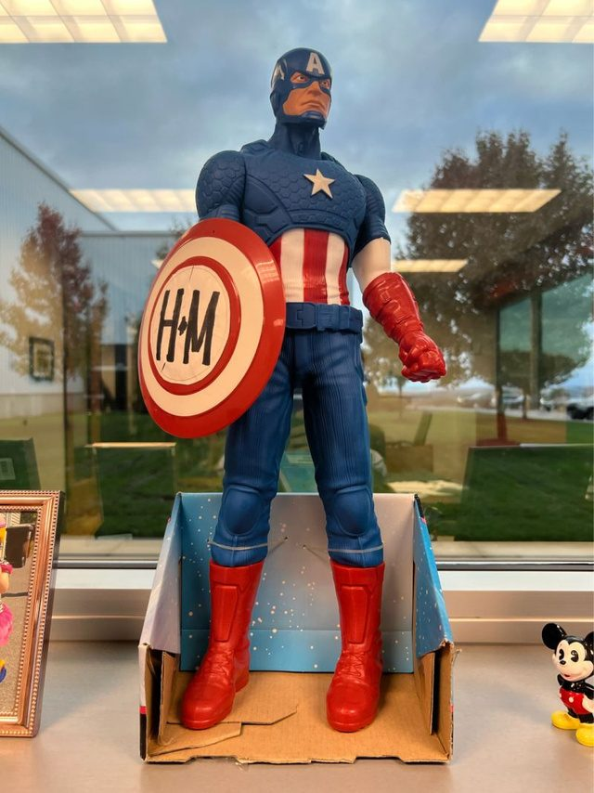
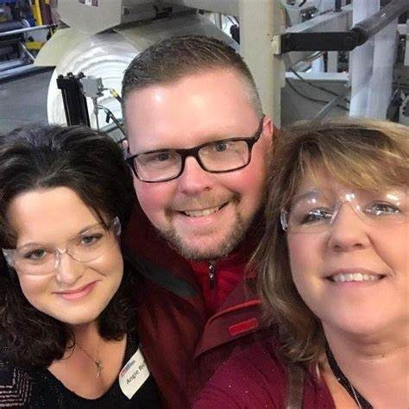
LESSON 9 OF 18
LESSON NINE:
MENTORS ARE CRITICAL TO SUCCESSION
“…wisdom is passed not just from generation to generation but across the organization.”
— Jennifer Pendergast, PhD, John L. Ward Clinical Professor of Family Enterprise, Kellogg School of Management
Mine
Jim, our VP of Sales
Gary Dake, President of Stewart’s
Our key sales reps
A vendor rep who wanted us to succeed
None of them shared my last name.
Notes:
CUES
TIME: 1¼ min — clock 21:00 → 22:15
• Pendergast quote — across the organization, not just down the family tree
• Jim (VP of Sales): recruited you home, never sugarcoated
• Gary Dake (Stewart’s): the quarterly lunches — timeframes
• The key sales reps who taught you to sell
• The vendor rep: the Captain America story (photo)
• Rule: the successor’s most important mentor should not be the parent
SCRIPT
Lesson Nine: mentors are critical to succession. Jennifer Pendergast at Kellogg says the best family businesses pass wisdom not just from generation to generation but across the organization. I can tell you that is true, because here are mine — and not one of them shared my last name.
Jim, our VP of Sales. He is the one who recruited me home, and he never once sugarcoated how the employees saw my parents, or me. [One line: the thing Jim told you that nobody in the family would have.]
Gary Dake, the president of Stewart’s. [The quarterly lunches: what he taught you about timeframes — the retiring generation wants no risk, the rising generation wants to make a mark, same calendar, different points on it.]
Our key sales reps — the people who taught me to sell, which is to say, taught me the business. [Name one. The golf photo.]
And a vendor rep who wanted us to succeed. [The Captain America story — the doll he sent after we lost the reps, and how he trained our sales team. Thirty seconds; it is the photo on the slide.]
Here is the rule I give every family now: the successor’s most important mentor should not be the parent. The parent is the boss, the owner, and the parent — three rooms in one person — and nobody can get honest feedback from someone who is also deciding their inheritance. Find your kid a Jim, a Gary, a sales rep, and a vendor who wants them to succeed.

Slide 15
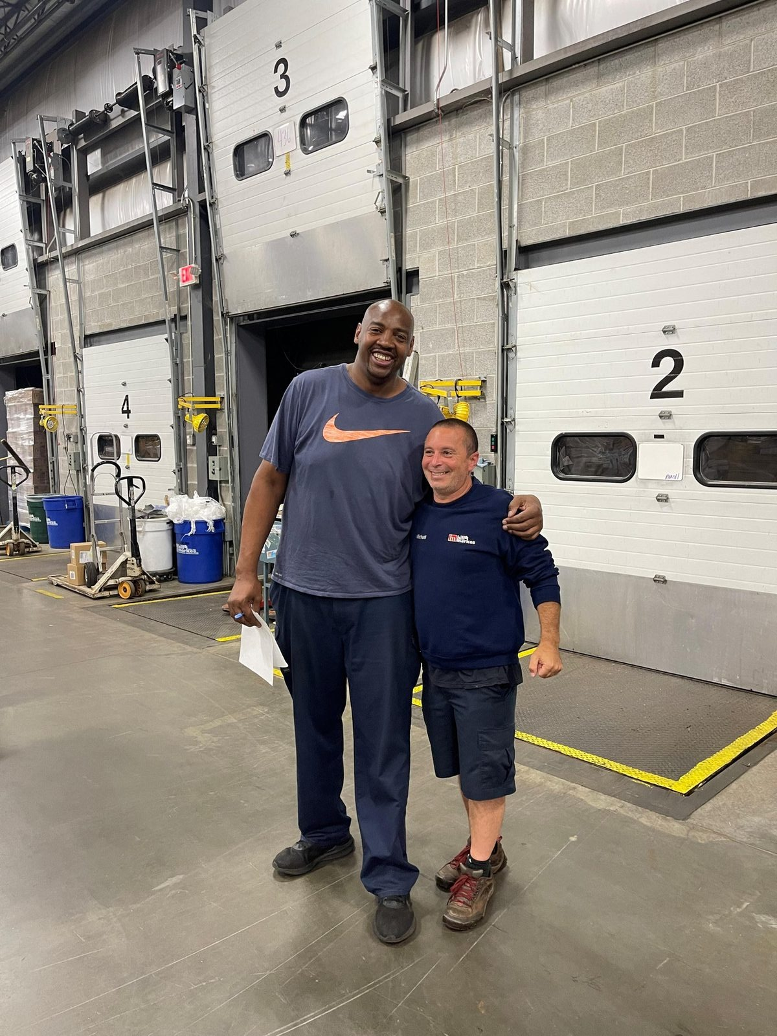

LESSON 10 OF 18
LESSON TEN:
TEACH SUCCESSORS TO LISTEN TO AND RESPECT EMPLOYEES
The successor should report to a non-family manager.
Notes:
CUES
TIME: 1¼ min — clock 22:15 → 23:30
• Warehouse photos
• Respect is earned on the dock, not announced in a memo
• Your story: the employee who taught you / the time you got it wrong
• Rule: the successor reports to a non-family manager
SCRIPT
Lesson Ten: teach successors to listen to and respect employees. These are our people. The fastest way to lose a company is a successor the employees do not respect — and respect is earned on the dock, not announced in a memo from the owner’s office.
[Your story: the employee who taught you something you could not have learned from your father — or the time you walked in acting like the owner’s kid and someone set you straight.]
The practice is simple and families skip it constantly: the successor reports to a non-family manager. A real job, a real boss, and a review written by someone who is not related to them. That is how the next generation learns the business the way the employees see it — and how the employees learn that the kid is earning it.

Slide 16
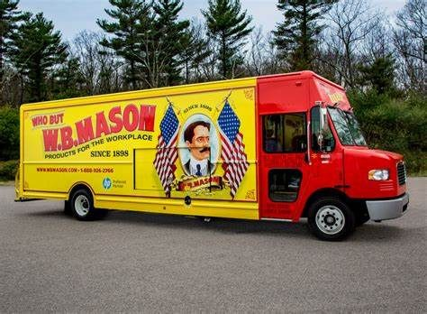
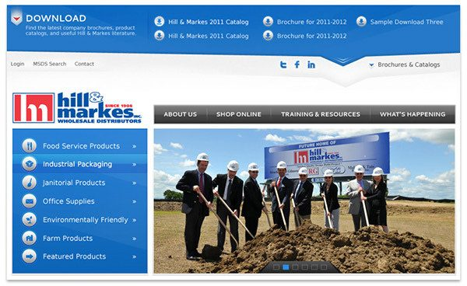

LESSON 11 OF 18
LESSON ELEVEN:
USE CHANGE AND PROBLEMS FOR SUCCESSION
Earn credibility through managing difficult problems.
Notes:
CUES
TIME: 1¼ min — clock 23:30 → 24:45
• Photos: the hard projects
• Every crisis is a succession opportunity
• Your example: the system conversion / the new competitor
• Give the next gen the problem, then get out of the way
SCRIPT
Lesson Eleven: use change and problems for succession. Every crisis is a succession opportunity in disguise. A new competitor shows up. The ERP system has to be replaced. A pandemic closes your customers. That is exactly when you hand the next generation something real.
[Your example from the photos — the technology conversion, the competitive threat, the project you were given or that you gave someone. What was the problem, who owned it, what did it prove?]
Here is why it works. A successor who has only ever been handed the good years has never been tested, and everyone in the building knows it. A successor who owned the hard project has a story the employees tell about them. You cannot give someone credibility. You can only give them the chance to earn it — and problems are the chance.

Slide 17

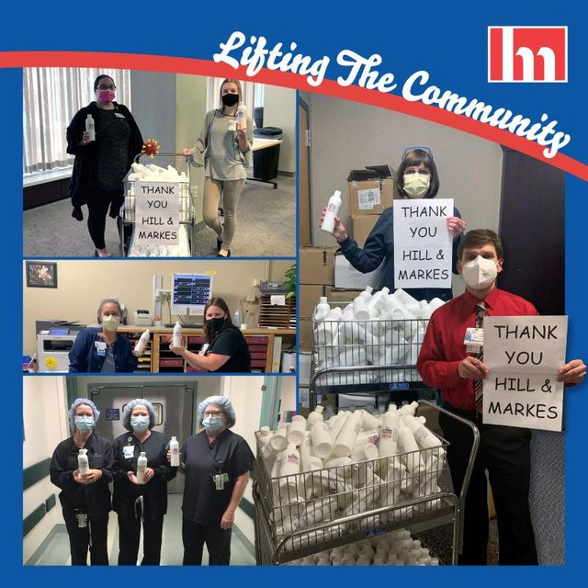

LESSON 12 OF 18
LESSON TWELVE:
FAMILY FIRMS MUST PIVOT AND
CHANGE WITH THE MARKETPLACE
Stick to your core values in the face of challenges — and adapt to the new environment.
Notes:
CUES
TIME: 1¼ min — clock 24:45 → 26:00
• Photos: the pivots
• Core values hold; the environment changes — adapt to it
• Your example: K-12 food service / webinars / new channels / COVID
• Next gen is usually the one who sees the pivot
SCRIPT
Lesson Twelve: family firms must pivot and change with the marketplace. The businesses that last a century are not the ones that kept doing the same thing. They stuck to their core values in the face of every challenge — and adapted to each new environment. The values are the keel. Everything else is sail.
[Your example from the photos — the K-12 food service push, the webinars, the new channels; or COVID, when half the revenue went behind locked doors and the question in the room was not “how do we cut” but “how do we grow.” What was the market telling you, who saw it first, what did it take to move — and what did you refuse to change?]
One pattern I see over and over: the pivot is usually spotted by the next generation and resisted by the senior one. That is not a character flaw on either side — the senior generation built the thing that works, and the next generation does not have the scar tissue. The families that adapt are the ones with a room where that argument can happen safely, and a set of values that nobody is arguing about. Which is Lesson Four again.

Slide 18


LESSON 13 OF 18
LESSON THIRTEEN:
HELP NEXT GEN BUILD IDENTITY
IN AND OUTSIDE THE BUSINESS
A successor with a diverse set of passions outside the business is more effective inside it.
Notes:
CUES
TIME: 1¼ min — clock 26:00 → 27:15
• Photos: Ibero, NYSID partnership
• Give the next gen something that is theirs and not the business
• Maggie and Caleb in the case gave theirs up on a handshake
• Identity outside + a seat inside
SCRIPT
Lesson Thirteen: help the next generation build identity in and outside the business. [Your example from the photos — the Ibero-American Action League board, the NYSID partnership. What was yours, outside the company, that was yours?]
A successor with a diverse set of passions outside the business is more effective inside it. Someone with nowhere else to stand cannot push back on the senior generation; someone with a board seat in the community, a partnership they built, a reputation that is not borrowed from the family name, brings a whole person back to the company.
Keep this in your pocket for the case study. Two kids in their twenties are about to leave real careers — their identity outside the business — because the family said “we need you.” Nothing wrong with coming home. Everything wrong with coming home on a handshake, with no seat in the owner room to go with it.

Slide 19

LESSON 14 OF 18
LESSON FOURTEEN: DECIDE WHO DECIDES
Avery Building Supply · est. 1878 · sixth generation
G4 — Grandpa
Walter (84) – Chairman. Owns 5% of the company — and 100% of the voting shares. Gave the economics away years ago for estate reasons; kept control. “Averys don’t sell.”
G5 — The brothers
Tom (58), CEO, and Rick (55), President – Own 95% between them, all of it non-voting. Thirty-five years each. Both want to sell.
G6 — The kids
Maggie (26) and Caleb (24) – Recruited home two years ago: “the business needs you.” Left real careers. Own nothing. Were promised “a path.” Nothing is in writing.
The offer
Meridian Capital – $100 million, cash, 90 days to close. Tom and Rick stay three years. The kids “would be evaluated.”
Walter says no, and Walter has every vote. Case closed — right?
The case on your phone
anderson-university-18-lessons.netlify.app
Notes:
CUES
TIME: 2.5 min — clock 27:15 → 29:45
• CHECKPOINT: you should be at ~28 min. Past 34? Cut pair time to 4 min, one report-out.
• POINT AT THE QR: “The whole case is on your phone — scan it now, you will want it in a minute.” Give them 20 seconds
• Read the Averys — one beat per generation
• VOTE before pairing: “Should the Averys sell? Hands up.” Count out loud, write the number down
• Point out the structure: 5% owns the vote, 95% owns the money, G6 owns nothing
• PAIRS: turn to your neighbor — one brother, one kid — assign NOW
• Ask: who do you recognize?
• Closer: “Case closed — right?” — let them answer
SCRIPT
Lesson Fourteen. Meet the Averys. Avery Building Supply, founded 1878. Six generations. [Read the slide — one beat per generation. Do not rush the ownership line; it is the whole case.]
Walter, eighty-four, chairman. Years ago, for estate reasons, he gave away ninety-five percent of the economics to his two sons — and kept one hundred percent of the vote. Five percent of the company, every single vote. “Averys don’t sell.” Tom, fifty-eight, the CEO, and Rick, fifty-five, the president. Thirty-five years each. They own ninety-five percent of the company and cannot vote a share of it. Both want to sell. Maggie, twenty-six, and Caleb, twenty-four — one from each branch. Two years ago Walter and their fathers recruited them home: “the business needs you.” They left real careers. They own nothing. They were promised “a path.” Nothing is in writing.
And three months ago, Meridian Capital offered one hundred million dollars. Cash, ninety days to close. Tom and Rick stay three years. The kids “would be evaluated.”
So: the brothers want to sell. The kids are fighting it — they just gave up their lives for this. And Walter says no, and Walter has every vote. Case closed — right? [Let the room answer. Someone will say “until he dies.” Good.]
Before we go further: turn to the person next to you. One of you is a brother — Tom or Rick. The other is one of the kids — Maggie or Caleb. Decide now, thirty seconds. [Wait.] If you came with your own parent or your own kid, you already know who you are.
Quick show of hands — who recognized this ownership structure? Who has a Walter? [Hands.] Now a real vote, and I am counting: should the Averys sell? Hands up for sell. [Count out loud; write it on your notes.] Hands up for keep. [Count.] Remember your vote. Because something is about to happen to Walter.

Slide 20
LESSON 14 OF 18
LESSON FOURTEEN: THE TWIST
Then Walter has a stroke.
He survives. But he no longer recognizes the warehouse, and his doctors will not certify that he can make decisions. His shares cannot be voted — until someone is legally appointed to vote them.
Within a week
  Meridian calls Tom: “The offer stands for thirty days. Then we move on to the next family.”
  Rick tells Caleb: “This isn’t your decision. You don’t own a share.”
  Walter’s lawyer finds the power of attorney. It names Ruth — 82, married to Walter for 61 years, never once at a shareholders’ meeting.
  Ruth calls the family together: “My values are family and community. Come to me with one approach — together.”
The man with the votes can’t vote. The men with the money can’t vote. And Ruth has thirty days.
Notes:
CUES
TIME: 1 min — clock 29:45 → 30:45
• Read slowly — this is the turn
• Stroke → no capacity → the vote is frozen
• Three calls: Meridian’s clock, Rick to Caleb, the lawyer finds the POA
• Beat: “It names Ruth.”
• Then Ruth’s ask: one approach, by consensus, walk away united, harmony throughout — “family and community”
• Last line: the man with the votes, the men with the money, and Ruth has thirty days
• Do NOT explain yet
SCRIPT
Then Walter has a stroke. He survives. But he no longer recognizes the warehouse, and his doctors will not certify that he can make decisions. And under the company’s own documents, his shares cannot be voted — until someone is legally appointed to vote them.
Within a week, three things happen. Meridian calls Tom: “The offer stands for thirty days. Then we move on to the next family.” Rick tells his own son Caleb: “This isn’t your decision. You don’t own a share.” And Walter’s lawyer goes looking for the power of attorney — and finds it. It names Ruth. Eighty-two years old. Married to Walter for sixty-one years. Has never once been to a shareholders’ meeting.
[Pause. Let the room sit with Ruth.]
And then Ruth does something nobody in that family expected. She calls them together — Tom, Rick, Maggie, Caleb — and she does not pick a side. She says: “Come to me with one recommended approach. Reach it by consensus. I want this family to walk away united, even if none of you gets exactly what you want. Keep the harmony while you work on it. My values are family and community.”
The man with the votes can’t vote. The men with the money can’t vote. The kids with their whole lives in it don’t own a share. And Ruth has thirty days. Your move.

Slide 21
LESSON 14 OF 18
LESSON FOURTEEN: YOUR MOVE
Six minutes with the person next to you
One of you is a brother — Tom or Rick. The other is one of the kids — Maggie or Caleb. Stay in role. Ruth has set the terms:
“Come to me with one recommended approach. Reach it by consensus. Walk away united, even if none of you gets exactly what you want. Keep the harmony while you work. My values are family and community.”
  The recommendation: What do you bring Ruth — sell, keep, or a third way? And what do you tell Meridian in the meantime?
  The consensus: What does each of you give up so the whole family can stand behind one answer?
  The harmony: How does this family stay united through the next thirty days — and after the decision, whichever way it goes?
Be ready to share the one thing you agreed on — and the one thing you fought about.
The case on your phone
anderson-university-18-lessons.netlify.app
Notes:
CUES
TIME: 8 min — clock 30:45 → 38:45
• QR again: the case, the twist and Ruth’s terms are on their phones — pairs can read instead of squinting
• HANDOUT 1: pass out the Avery case sheet NOW, one per person (facts + the three questions only — no answers on it)
• Ruth’s terms frame everything: one approach, consensus, united, harmony
• 6 min in pairs + 2 min report-outs
• Circulate — listen for who takes Ruth’s terms seriously vs. who just picks a winner
• At 3 min, inject: “Meridian just told Tom they’d go to $110M if it closes in 30 days”
• At 5 min: one-minute warning
• Report-outs: 3 pairs, 30 seconds each — one agreement, one fight
SCRIPT
[Hand out the case sheet now. Tell them: everything you have just heard is on it, so you do not have to remember it — Ruth’s terms and the three questions are at the bottom.]
Six minutes with the person next to you, in role. One of you is a brother. Tom, you have given this company thirty-five years, you are tired, and a hundred million dollars is a number nobody in your family has ever seen. Rick, your kids are not in the business — except Caleb, who is now on the other side of the table from you. The other one of you is a kid. Maggie, Caleb — you quit real jobs because this family asked you to, and you own nothing.
And Ruth has set the terms. Not two plans — one recommended approach. Not a vote — consensus. And she wants you to walk away united, even if neither of you gets exactly what you want, with the harmony intact while you work. Her values are family and community. That is the assignment.
Three questions, on the sheet. The recommendation: what do you bring Ruth — sell, keep, or a third way — and what do you tell Meridian in the meantime? The consensus: what does each of you give up so the whole family can stand behind one answer? And the harmony: how does this family stay united through the next thirty days, and after the decision, whichever way it goes?
Facilitation: circulate. Listen for who takes Ruth’s terms seriously — consensus and harmony — and who just tries to win. In most pairs somebody tries to win first. That is the point. At the three-minute mark, escalate: “Meridian just told Tom they would go to one hundred ten if it closes in thirty days.” At five minutes, give a one-minute warning.
Report-outs: three pairs, thirty seconds each. The question is exactly what the slide says: the one thing you agreed on, and the one thing you fought about. The fights are the lesson.

Slide 22
LESSON 14 OF 18
LESSON FOURTEEN: THE DEBRIEF
Three or four pairs, one minute each. Shout it out — I’ll write it down.
What did you agree on?
What did you fight about?
What would have changed the story for the Averys?
Your ideas first. Then the one thing I would tell this family.
Notes:
CUES
TIME: 4 min — clock 38:45 → 42:45
• THIS IS THEIR TIME: facilitate, do not lecture. Flip chart or whiteboard ready
• Round 1: three or four pairs — the one thing you agreed on, the one thing you fought about
• Round 2: build the list — what would have changed the story? Write every answer up
• Name Ruth’s terms out loud: one approach, consensus, united, harmony — that is a family that decided how to decide
• RE-VOTE: “Should the Averys sell? Hands up.” Count, compare to the first vote, announce the shift
• Not a lawyer: who votes incapacitated shares depends on the documents
• LAST: your one thing — decide who decides — then HANDOUT 2 (the take-home is the answer key)
• Bridge: that is Lesson Fifteen
SCRIPT
Your turn. Three or four pairs, one minute each. What is the one thing you agreed on, and the one thing you fought about? [Pick a brother-and-kid pair that was loud. Repeat each answer back so the room hears it. Do not evaluate; just write.]
Now build the list with me. What would have changed the story for the Averys? Shout it out. [Write every answer up as they come. Prompt only if the room stalls: “What would have had to exist before Meridian called?” “What did the kids need in writing?” “Who should Ruth have been able to call?” You are listening for: a shareholders’ agreement written for a sale; a successor for Walter’s vote; the kids recruited on paper; a family advisor already in the room; a third way between sell and keep. When the room says it, circle it.]
The vote again. Should the Averys sell? Hands up for sell. [Count.] Hands up for keep. [Count.] [Compare to the first vote.] That many of you changed your mind in eight minutes of talking to one other person. Imagine what a family could do with a year — if it had a room to do it in.
Here is the one thing I would tell this family, and it is already on your list: the offer did not divide the Averys. It revealed that nobody had ever decided who decides. I am not a lawyer — who gets to vote an incapacitated owner’s shares depends entirely on the documents, a power of attorney, a trust, or a judge — so the first call is to Walter’s lawyer, not to Meridian. Then all three generations in one room, including Ruth, with someone who is not an Avery running it. Decide how the decision will be made before anyone knows the answer. Then build the third way.
[Hand out the take-home sheet now — it has the full answer key and the eight questions for their own family.] Which brings us to Lesson Fifteen.

Slide 23

LESSON 15 OF 18
LESSON FIFTEEN:
BE ALIGNED AND TRANSPARENT AROUND EXIT — AND KEEP YOUR FAMILY ADVISOR CLOSE
Ron Reece
Notes:
CUES
TIME: 2 min — clock 42:45 → 44:45
• The Averys recruited the kids home without telling them the owners wanted out — the anti-pattern
• H&M sale: aligned BEFORE the first banker called
• Your story: who was in the room, how the family decided
• SALUTE RON REECE — what Ron did for our family
• Advisor = the one person in all four rooms
• In this room, Brad is that person for many of you
SCRIPT
Lesson Fifteen: be aligned and transparent around exit — and keep your family advisor close. Think about what the Averys did: the two people who own ninety-five percent of the company had been quietly wanting out for years, while the family recruited two kids home with “the business needs you.” Nobody lied. Nobody aligned, either. That is the single most common mistake I see: the exit conversation happening in pieces, in private, in the wrong order, until a buyer forces it into the open at the worst possible moment.
When we sold Hill & Markes in 2022, we got to four times the industry average valuation. I will tell you the honest reason: the family was aligned before the first banker ever called. [Your story: who was in the room, how the decision was made, how long it took, what the hardest conversation was.]
And this is Ron Reece. Ron was our family’s advisor through the years I was in the business — you met him in Lesson Four — and I want to say publicly what I should have said more often privately: [what Ron did — the conversation he made possible, the moment he told you something you did not want to hear, the thing that would not have happened without him].
A family advisor is the one person who is allowed in all four rooms. Not the lawyer, not the banker, not the accountant — someone whose job is the family. The person who can say, “Walter, who votes your shares if you can’t?” years before the stroke, and be answered. Find your Ron before you need him. And for a lot of you in this room, you already have one — Brad and this Institute are that for families all over this state.

Slide 24

LESSON 15 OF 18
THE UNDERTAKERS
The people in dark suits who show up when you sell.
Notes:
CUES
TIME: ½ min — clock 44:45 → 45:15
• Men in Black = the people in dark suits who show up at the sale
• Good at their job; their job is not your family
• Your story: who they were, the one thing you wish someone had told you
SCRIPT
The Undertakers. When you sell, the people in dark suits show up. [Who they were for you — the bankers, the lawyers, the buyer’s diligence team, the integration people. Keep it light; the slide is doing the joke.]
They are very good at their jobs. I want to be fair to them. But their job is the transaction, and the transaction is not your family. Nobody on the deal team is paid to ask how your mother is going to feel when the sign comes down.
[The one thing you wish someone had told you about the deal team — one sentence.]
Which brings us to the part of the sale nobody prepares you for.

Slide 25
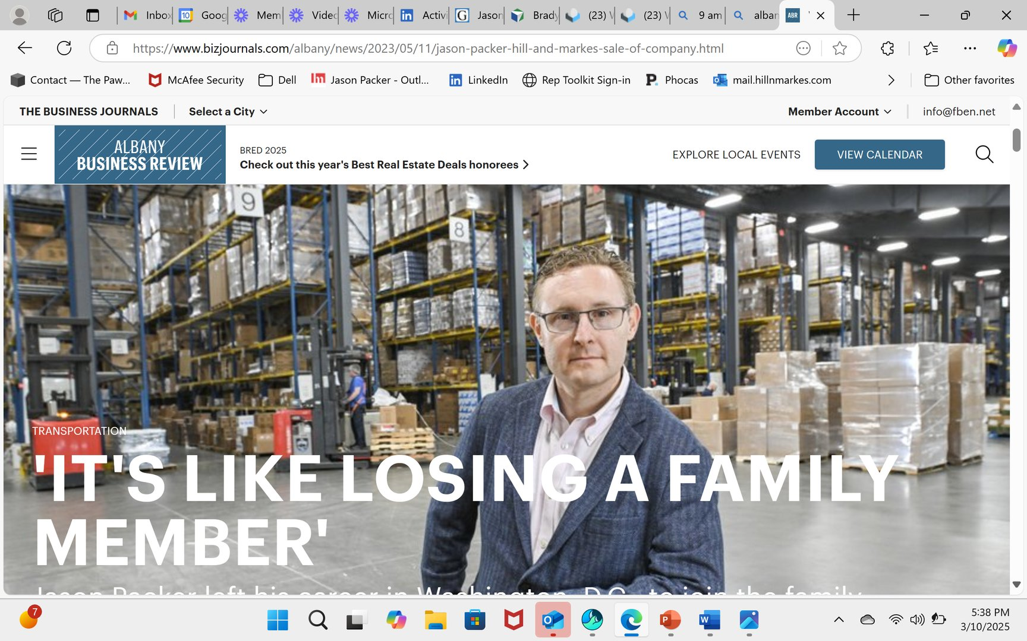
LESSON 16 OF 18
LESSON SIXTEEN: PREPARE FOR
LOSS AFTER THE SALE
Notes:
CUES
TIME: 1.5 min — clock 45:15 → 46:45
• "It’s like losing a family member" — you said it to a reporter, you meant it
• The sale is a death; nobody sends a casserole
• Identity, routine, the people
• Plan the year after before you sign
SCRIPT
Lesson Sixteen: prepare for loss after the sale. I said that line to a reporter — “it’s like losing a family member” — and I meant it. Nobody warns you. The sale is a death, and nobody sends a casserole, because from the outside it looks like you just won.
You lose three things at once. Your identity — for sixteen years the answer to “what do you do” was the company. Your routine — the dock at six in the morning. And the people — the ones from Lesson Ten, who are now someone else’s people. [Your own version: the first Monday after the close.]
The practical lesson: plan the year after the sale before you sign. Not the money — the money has twelve advisors. The mornings. What are you going to do on the first Monday? If you do not have an answer, do not sign yet.

Slide 26
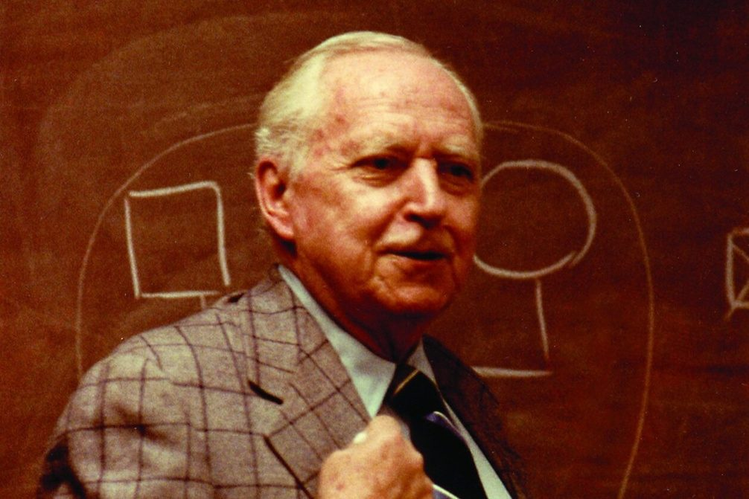
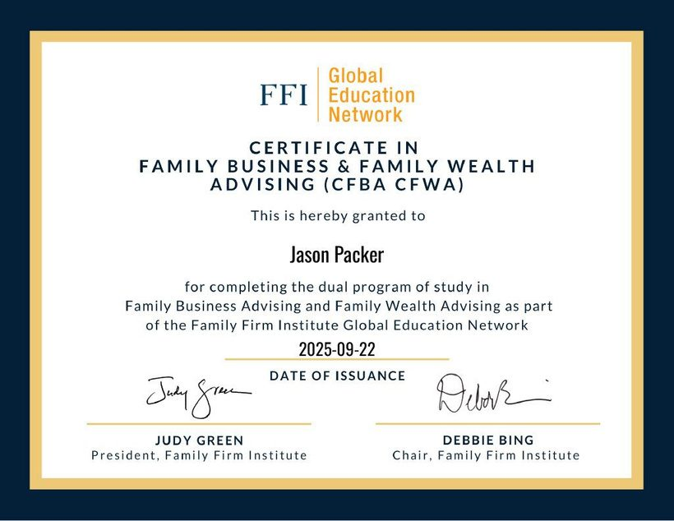
LESSON 17 OF 18
LESSON SEVENTEEN: FIND PURPOSE
AFTER THE SALE
Redirection.
Notes:
CUES
TIME: 1 min — clock 46:45 → 47:45
• Went back to school: Bowen, FFI (CFBA/CFWA), UW-Superior
• Purpose = turning what you lived into what you can teach
• Murray Bowen photo: family systems
• Redirection
SCRIPT
Lesson Seventeen: find purpose after the sale. I went back to school. Murray Bowen’s family systems theory at the Bowen Center. The Family Firm Institute certifications in family business and family wealth advising. [The UW-Superior program — one line on what it was.]
I did not do it to get a new job. I did it because I needed to understand what had just happened to my family — and once I understood it, I could not stop seeing it in every other family I met. Purpose, it turns out, is just what you lived, turned into what you can teach.
The founders in this room are going to sell or hand off someday. The word you want for what comes next is redirection. You are not done. You are just done with that.

Slide 27
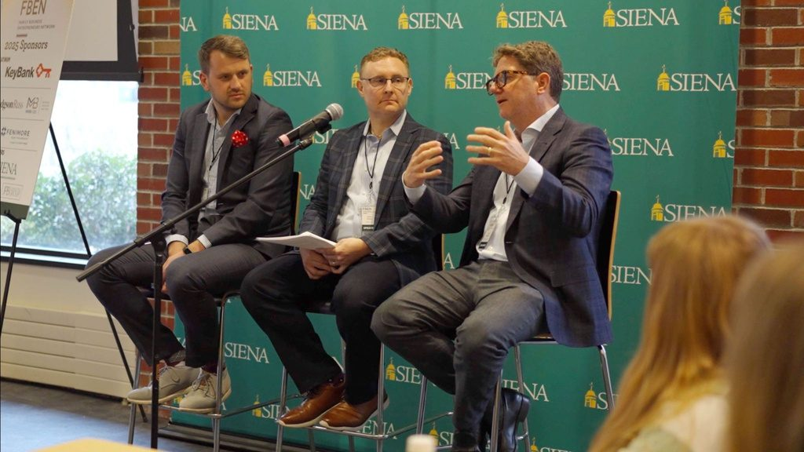
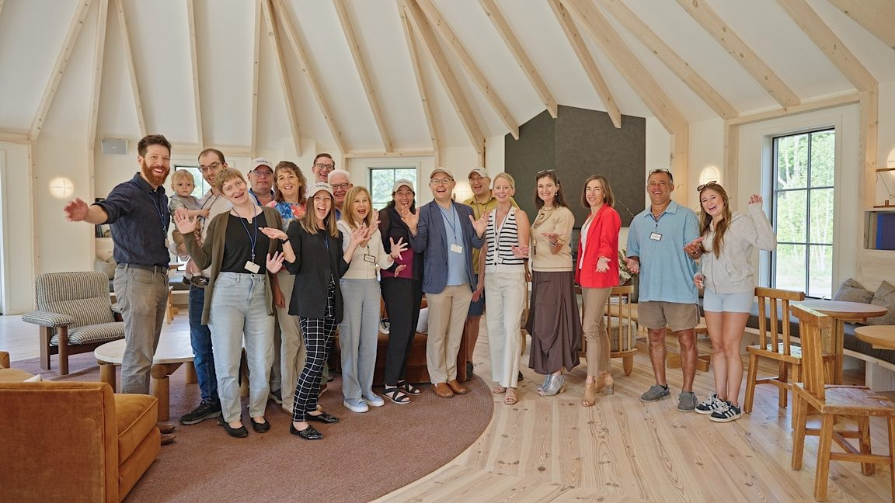
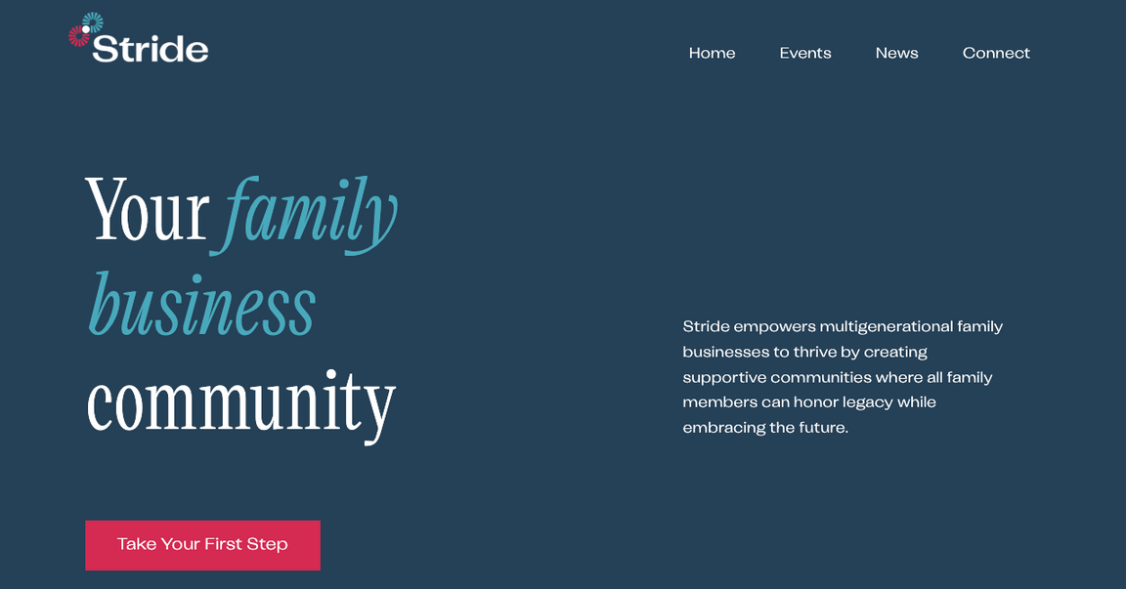
LESSON 18 OF 18
LESSON EIGHTEEN: FIND COMMUNITY
Notes:
CUES
TIME: 1 min — clock 47:45 → 48:45
• Stride photos
• Community is the part of family business you keep
• What Stride is: peer groups (Rising Gen, Stewards), retreats
• Invitation
SCRIPT
Lesson Eighteen: find community. This is Stride — the family business community I built after the sale, because the thing I missed most was not the company. It was the people who understood the company.
Peer groups for the rising generation and for the stewards running things now. Retreats. A room where you can say the thing you cannot say at Thanksgiving — which is where we started today.
Community is the one part of a family business you get to keep after the business. You do not need Stride to have it — but you do need it. Find your room.

Slide 28
THANK YOU,
ANDERSON UNIVERSITY!
The Kim S. Miller Family Enterprise Institute of South Carolina
Jason Packer, Founder of Stride
The slides, the case and the 18 lessons
anderson-university-18-lessons.netlify.app · jpacker@stridefba.com
Notes:
CUES
TIME: 1 min — clock 48:45 → 49:45
• Brad and the Institute, then Ron
• The ask: one conversation, this month
• Point at the QR: slides, case, 18 lessons, and you — the address is printed under it
• Slide stays up through Q&A
• End on your line, then stop
SCRIPT
Thank you, Anderson University, and thank you, Brad, for building a place where these conversations can happen. And thank you to Ron, for the years when they happened for my family.
One thing before you go. One conversation. This month. Pick the one your family has not had — and if you do not know which one, it is this one: who decides, if the person who decides can’t? Go home and have it in the right room.
That code takes you to the slides, the Avery case, the eighteen lessons on one page — and to me. If you want to keep talking, I would love to. Thank you.
[Leave the slide up for Q&A. Seed it if the room is quiet: “Ask me the question you would want to ask your own family.” Two in your pocket: “What if the senior generation refuses to talk about it?” and “How do you pay the next generation before they own anything?” End Q&A on your own last line, not on a questioner’s.]

